Slide 1
Unit 8: Celebration
Reading

Slide 2
Father’s Day
To celebrate the contributions of fathers
To express feelings & opinions of children about their fathers
On the third Sunday of June

Slide 3
Before you read

Slide 4
Vocabulary

Slide 5
hug /hʌɡ/ (v)
ôm
priority /praɪˈɒrəti/(n)
sự ưu tiên
generous /ˈdʒenərəs/ (a)
rộng rãi, hào phóng
considerate /kənˈsɪdərət/ (a)
ân cần, chu đáo
humor /ˈhjuː.mɚ/ (n)
sự hài hước
distinguish /dɪˈstɪŋɡwɪʃ/ (v)
phân biệt
terrific /təˈrɪfɪk/(a)
= wonderful
tuyệt vời
proud /praud/ (+of)
tự hào, hãnh diện
groom /ɡruːm/ (n)
chú rể

Slide 6
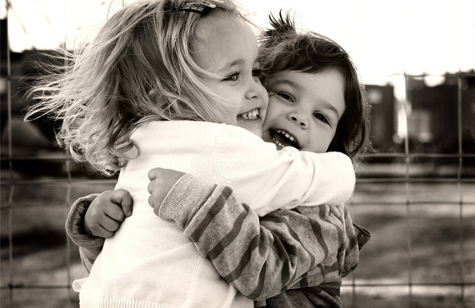
Hug (v)
ôm

Slide 7
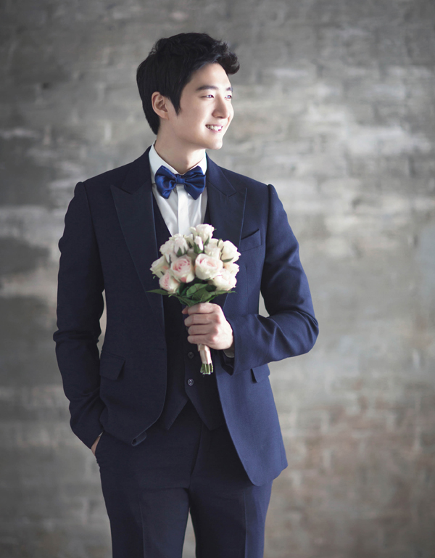
groom /ɡruːm/ (n)
chú rể

Slide 8
Slap the board

Slide 9
While you read

Slide 10
Task 1:
Complete the table

Slide 11
 | Who?
1.He had a sense of humor
2.He cried on her wedding
3.He seemed to be her teacher
4. According to the son, he was the best person
Bob’s father
Jane’s father
Rita’s father
Bob’s father

Slide 12
Task 2
Answer questions

Slide 13
1. Who do you think Rita sends this card to?
Rita sends this card to her father
2. Is Jane’s father alive or dead? How do you know this?
He is possibly dead. “ How much you are missed..., I now have children, Dad,….”
3. What quality makes Bob’s father different from others?
His sense of humor makes him different from others
4. What image of a father can you draw from three passages?
The best person in the world, a teacher, a friend...

Slide 14
After you read

Slide 15
Tell your friends about your father
+How old is he?
+What does he do?
+What are your feelings and opinions about him?
For me, my father is a terrific man. He is 50 years old and he is a doctor. My father is really clever. He helps me to learn subjects at school. Moreover, my father is also my friend. He always shares with me his all the bad an happy moments. My father is my ideal model. He is the person who I wish to become like

Slide 16
Vocabulary
Father’s Day
Discussion

Slide 17

Thanks
Photo by Markus Spiske · CC-License: CC BY · blogcongdong.com

Slide 18
To the extent possible under law, http://www.slidescarnival.com has waived all copyright and related or neighboring rights to these Christmas Icons.

